Slide 1
Student Seminar - IDP
Presentation 2
Can Ersoy - 06.10.2026

Slide 2
Topics from Previous Meeting
Discarded Golden Dataset Paper
Changing Search Query

Slide 3
Changing Search Query
New NCBI Query: “peptide self-assembly”
Includes paper: Self-Assembly of Block Heterochiral Peptides into Helical Tapes [1]
9631 results as of 30.09
[1]: Clover TM, O'Neill CL, Appavu R, Lokhande G, Gaharwar AK, Posey AE, White MA, Rudra JS. Self-Assembly of Block Heterochiral Peptides into Helical Tapes. J Am Chem Soc. 2020 Nov 25;142(47):19809-19813. doi: 10.1021/jacs.9b09755. Epub 2020 Apr 27. PMID: 32338879; PMCID: PMC7606833.
Notes:
Includes paper mentioned by Nuno
Q: Is it a better idea to use a query like this and have every paper go through relevance check?

Slide 4
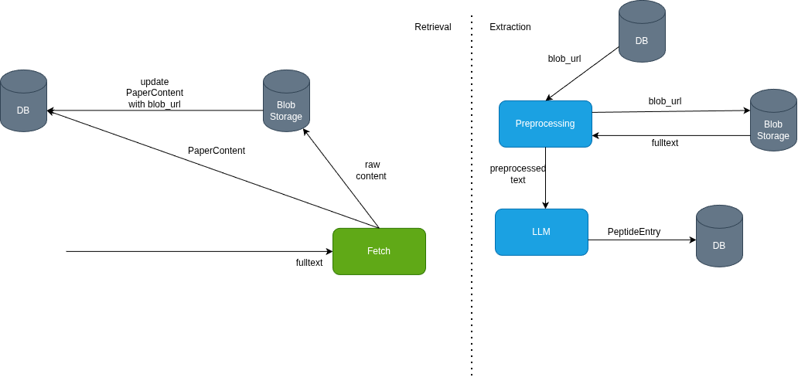
New Way to Store Papers
Full Text retrieval doesn’t scale well
Solution: Azure Blob Storage

Slide 5
Pdf Paper Full Text
OpenAlex can be used to find open-access pdf urls.
Tested 50 dois, only got 3 pdfs.
Some pdf urls are behind bot check (not programmatically accessible)
Notes:
Pdfs are available but are behind paywall or institutional access. It is prohibited to programmatically download these.

Slide 6
Extraction
1. Way: Pass full-text directly to LLM
2. Way: Pass only specific sections (Methods, Experiments, Materials etc.) -> similar to PeptideMiner
3. Way: Pass only paragraphs that include specific keywords
SYSTEM_PROMPT: You will receive the full text of a scientific paper and your goal is to extract experimental peptide self-assembly information according to the given schema. There can be several entries in a single paper be careful! If a field is not provided give "NP" for that field and write nothing else. Don't leave any fields empty
PEPTIDE_MINER_SYSTEM_PROMPT: polypeptide self-assembly literature information extraction
Notes:
2. And 3. Way are just some ideas and not sure if we need them… It was mostly needed for peptideminer where the context length was 4k tokens…
Now even small models can work with full-text (around 15k tokens)

Slide 7
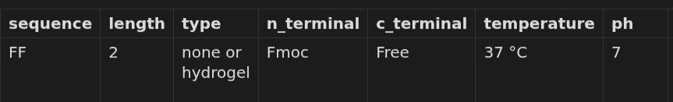

Example Paper PMID: 18070345
PeptideMiner (4 entries - 1 hydrogel 3 none)
Extraction (1 entry)
Notes:
DIfference in temperature: There is the following exact sentence in the paper: All hydrogels were assembled at room temperature (~20°C) so temperature effects on hydrogel self-assembly was not addressed. Which probably made the llm use that.
As I understand, PeptideMiner used cell culting temperature here for some reason (which was 37)...

Slide 8
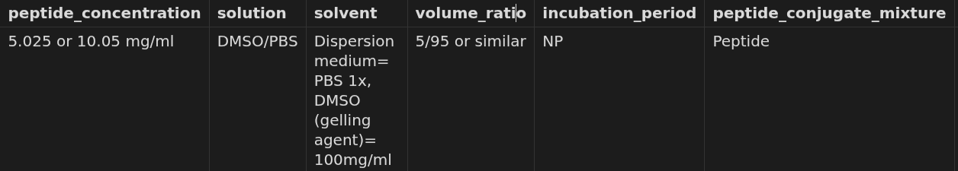
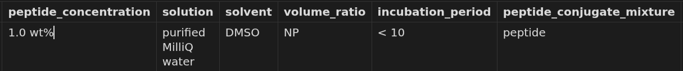
PeptideMiner
Extraction
Notes:
It actually captured the peptide_concentrations from 0.5 to 1.0 wt (5 to 10 mg/ml) but didn't create new entries
Incubation time: Macroscale samples (1 ml) assembled stable hydrogels in less than 10 minutes, while less time was required for smaller sample volumes. This sentence probably made the result. Compared to NP from peptideminer.

Slide 9
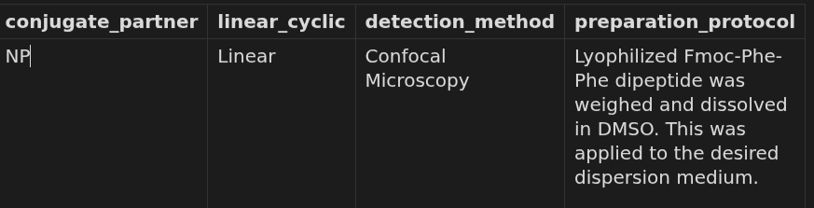
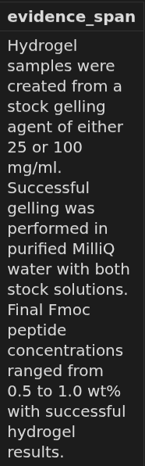
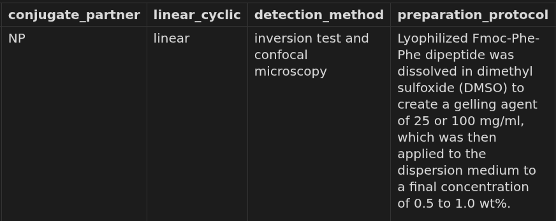
PeptideMiner
Extraction

Slide 10
Extraction Notes
Pydantic field descriptions matter
System prompt matters
Assumptions matter
Fine-tuning (?)
Notes:
Changing pydantic field descriptions also change extraction…
Tried slightly changed system prompts and results got better/worse
PeptideMiner has some assumptions (like temperature not provided is always assumed to be 25 degrees)

Slide 11
Next Steps
Try different approaches for extraction and document the outcomes
Get access to local LLM

